Slide 1
Implementing Type Mappings with the JAXB 2.0 Binding Language
Service-Oriented Software Engineering
Software Institute
Nanjing University
Bei Jia

Slide 2
Implementing Type Mappings with the JAXB 2.0 Binding Language
JAXB run-time implementation needs annotations for marshalling and unmarshalling
So, the SFW mode is based on adding binding language declarations to an XML schema that the JAXB schema generator interprets and uses to generate annotated Java code
In this manner, the binding language is a tool for customizing the default behavior of the schema compiler
We start with the oms:simpleOrder , and try to define
  < oms:simpleOrder, samples.MySimpleOrder >
  < oms:billTo, samples.MyAddress >
  < oms:items, List<samples.MyItem> >
  < oms:item, samples.MyItem >

Slide 3
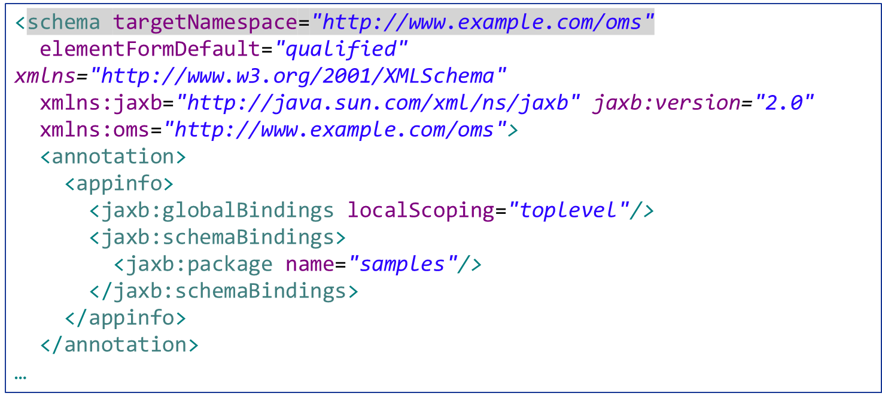
Schema with Binding Declarations simpleorder with bindinglang.xsd (1/2)
Binding declaration inside
Global binding, affect the mapping of the entire schema and any schemas that are included or imported. None of the generated classes should be inner classes
Schema binding. Specifies the package

Slide 4
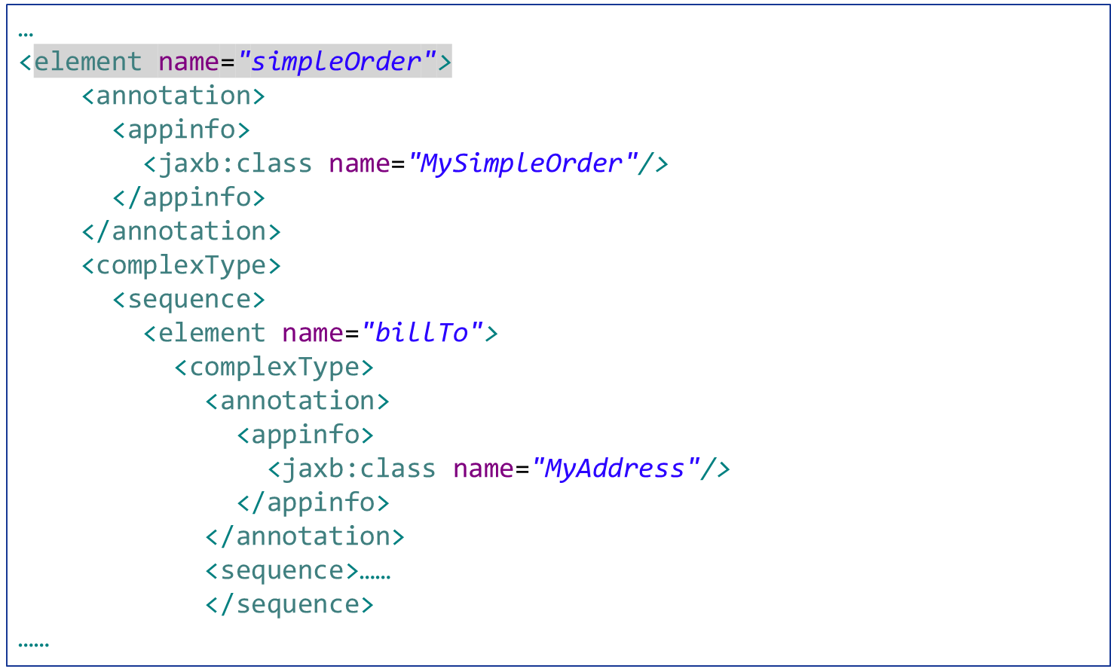
Schema with Binding Declarations simpleorder with bindinglang.xsd (2/2)
The name of target classes

Slide 5
MySimpleOrder.java Generated
…
@XmlAccessorType(AccessType.FIELD)
@XmlType(name = "", propOrder = {
"billTo",
"items"
})
@XmlRootElement(name = "simpleOrder")
public class MySimpleOrder {
@XmlElement(namespace = "http://www.example.com/oms")
protected MyAddress billTo;
@XmlElement(namespace = "http://www.example.com/oms")
protected Items items;
……

Slide 6
Items.java Generated
…
@XmlAccessorType(AccessType.FIELD)
@XmlType(name = "", propOrder = {
"item"
})
public class Items {
@XmlElement(namespace = "http://www.example.com/oms")
protected List<MyItem> item;
……

Slide 7
Datatype Conversions Example simpleorder with bindinglang.xsd (1/2)
XML schema atomic datatype
…
<element name="quantity" type="positiveInteger">
<annotation>
<appinfo>
<jaxb:property>
<jaxb:baseType>
<jaxb:javaType name="int"
parseMethod="javax.xml.bind.DatatypeConverter.parseInt"
printMethod="javax.xml.bind.DatatypeConverter.printInt"/>
</jaxb:baseType>
</jaxb:property>
</appinfo>
</annotation>
</element>
……
customize the binding of an XML schema atomic datatype to a target Java datatype
Java datatype
Static Java methods for marshalling/unmarshalling

Slide 8
Datatype Conversions Example simpleorder with bindinglang.xsd (2/2)
…
<element name="price" type="double">
<annotation>
<appinfo>
<jaxb:property>
<jaxb:baseType>
<jaxb:javaType name="float" parseMethod="javax.xml.bind.DatatypeConverter.parseFloat"
printMethod="javax.xml.bind.DatatypeConverter.printFloat"/>
</jaxb:baseType>
</jaxb:property>
</appinfo>
</annotation>
</element>
……
SAME

Slide 9
MyItem.java generated
…
@XmlAccessorType(AccessType.FIELD)
@XmlType(name = "ItemType", propOrder = {
"quantity",
"price"
})
public class MyItem {
@XmlElement(namespace = "http://www.example.com/oms", type = String.class)
@XmlJavaTypeAdapter(Adapter1.class)
protected Integer quantity;
@XmlElement(namespace = "http://www.example.com/oms", type = String.class)
@XmlJavaTypeAdapter(Adapter2.class)
protected Float price;
@XmlAttribute(required = true)
protected String productName;
……
Use adapters for marshalling/unmarshalling

Slide 10
Adapter1.java generated
…
public class Adapter1
extends XmlAdapter<String, Integer>
{
public Integer unmarshal(String value) {
return (javax.xml.bind.DatatypeConverter.parseInt(value));
}
public String marshal(Integer value) {
return (javax.xml.bind.DatatypeConverter.printInt(value));
}
}
…
Defined by binding language declarations

Slide 11
Marshal/Unmarshal example
MySimpleOrderSerializer.java
…
JAXBContext jaxbContext = JAXBContext.newInstance(MySimpleOrder.class);
Marshaller jaxbMarshaller = jaxbContext.createMarshaller();
jaxbMarshaller.setProperty(Marshaller.JAXB_FORMATTED_OUTPUT,
Boolean.TRUE);
SchemaFactory sf =
SchemaFactory.newInstance(XMLConstants.W3C_XML_SCHEMA_NS_URI);
Schema schema = sf.newSchema(
new URL("http://soabook.com/example/oms/simpleorder.xsd"));
jaxbMarshaller.setSchema(schema);
ByteArrayOutputStream ba = new ByteArrayOutputStream();
jaxbMarshaller.marshal(myOrder, ba);
Unmarshaller u = jaxbContext.createUnmarshaller();
MySimpleOrder roundTripOrder =
(MySimpleOrder) u.unmarshal(new StringReader(ba.toString()));
…

